Slide 1
Visual memory task
Pilot 1

Slide 2
83 total subjects
17 qualified subjects
Qualifications :
1/1 in demo encoding attention task
Demo test accuracy above 0.5
Encoding attention check above 0.6
Response time bellow 10 seconds and above 300 ms

Slide 3
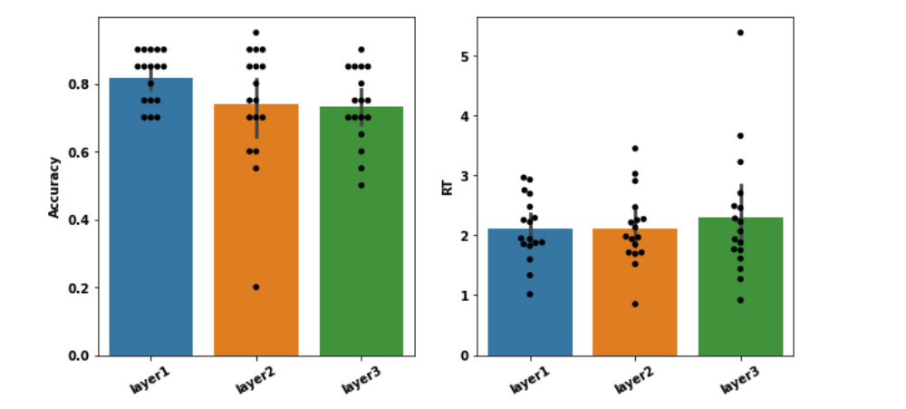

Slide 4
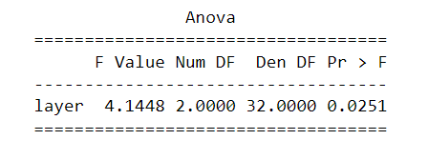
Correlation between accuracy and rt is 0.03
ANOVA results :

Slide 5
Testing qualifications for inclusion
Qualification |  | P - value | Passed mean | Failed mean
Demo accuracy | t((36, 43)) = 4.747 | p = 0.00 | 0.72 | 0.6
Demo attention | t((42, 37)) = 2.175 | p = 0.033 | 0.69 | 0.63
Encoding accuracy | t((36, 43)) = 2.443 | p = 0.017 | 0.69 | 0.63
Response strike | t((67, 12)) = 4.568 | p = 0.00 | 0.68 | 0.53
Not too fast | t((59, 20)) = 7.949 | p = 0.00 | 0.71 | 0.52
Not too slow | t((74, 5)) = -0.860 | p = 0.392 | 0.65 | 0.70

Slide 6
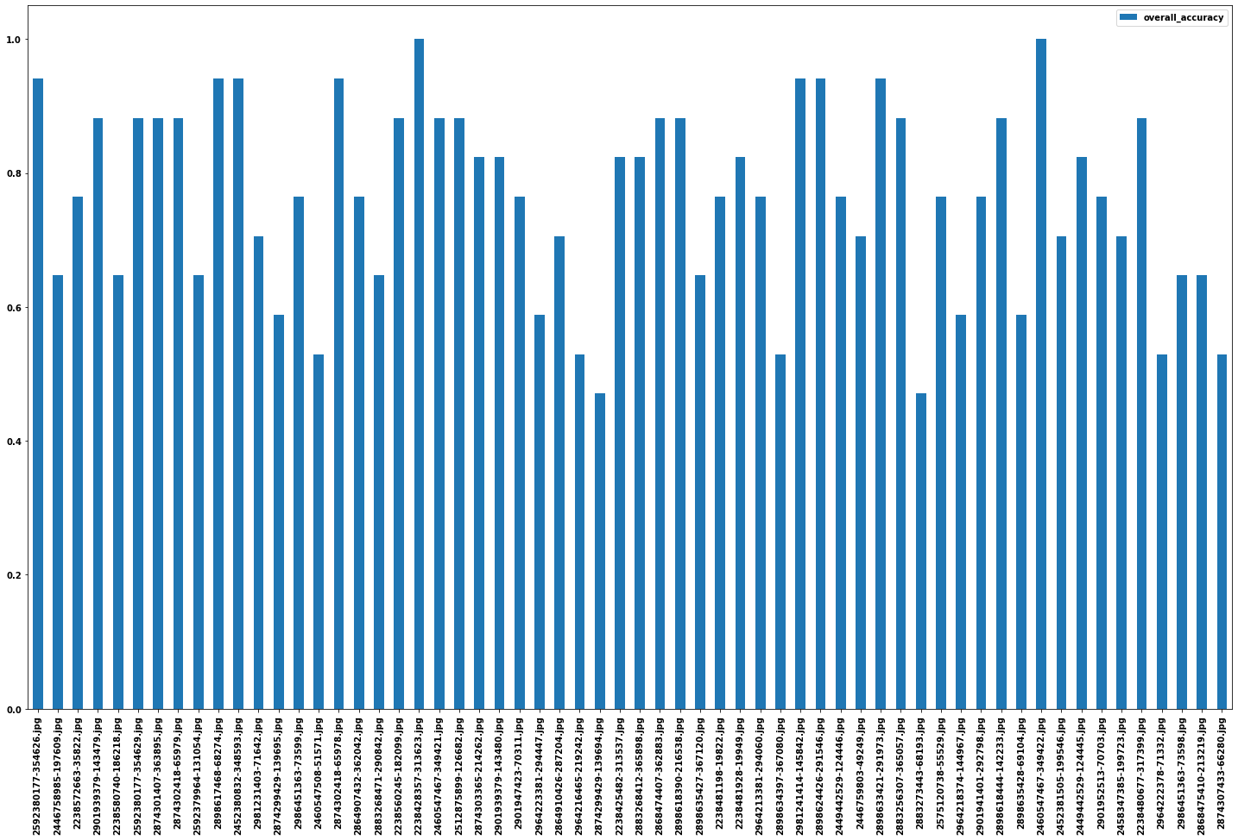
Should we replace any of the 60 target images?

